Slide 1
AI-Drievn Layout-Aware RTL Optimization Loop
Pipeline × Cognix
TEAM MEMBERS :
Bhanuja Karumuru
Harshal Pimpalshende
Abhishek Bharadwaj
Saishruti Veda
AI-Powered RTL Verification & Self-Optimizing
Cognix (ACI) | Hackathon 2026
https://github.com/Bhanuu01/AI-Drievn-Layout-Aware-RTL-Optimization-Loop.git

Slide 2
Table of Contents
About the Project
3
Key Features
8
The Problem
4
Demo & Results
9
Our Solution
5
Tech Stack
10
Pipeline Architecture
6
Roadmap
11
Why Now
7

Slide 3
About the Project
We build an AI-driven RTL verification and self-optimizing pipeline that automatically detects, diagnoses, and fixes hardware design bugs — reducing manual debug cycles from hours to seconds.
3
5ns
AI
STAGES
TARGET
Sim → Synth → Timing
POWERED
Clock Constraint (200MHz)
Cognix (ACI) LLM Fixes
Verilator
Yosys
OpenSTA
Cognix AI

Slide 4
The Problem
Debug Time Breakdown
SLOW, MANUAL, ERROR-PRONE LAYOUT DESIGNING
Simulation Debug
40%
RTL engineers spend 60–70% of project time on debugging. Traditional flows rely on manual review of Verilator logs, Yosys reports, and STA output — disconnected tools with no automated remediation. Subsequently, the RTL codes usually do not have design fixes for some parameters that can be optimized in the code before handover to layout engineer.
Synthesis Review
20%
Timing Analysis
25%
No automated bug-fix loop
Timing violations caught too late
Context lost across tool boundaries
Repeated manual iteration cycles
Integration Fixes
15%

Slide 5
Our Solution
AI Self-Optimizing RTL Pipeline
Sim Bugs Fixed
Verilator → Cognix loop
An automated pipeline that ties Verilator simulation, Yosys pre-synthesis, and OpenSTA timing analysis into a single loop — with Cognix AI generating and applying targeted RTL fixes at each failure point.
Synth Clean
Yosys latch/loop detection
Auto-checks RTL + testbench files
Runs full 3-stage verification
Formats context-rich prompts for Cognix
Watches for file save → auto-reruns
Archives every successful run with logs
Timing Met
STA WNS < −0.1 ns threshold

Slide 6
Pipeline Architecture
📁
⚡
🔩
⏱
✓
test/*.sv
Verilator
Yosys
OpenSTA
✅ PASS
RTL + TB Input
Simulation
Pre-Synthesis
Timing STA
All Checks Done
AI FIX LOOPS
SIM FAIL → Cognix formats prompt with Verilator + Yosys logs → Apply fix → Re-run
SYNTH FAIL → Cognix gets Yosys blocking issue context → Fixes latches/loops → Re-run
TIMING FAIL → Cognix receives WNS/TNS + critical path → Restructures RTL → Re-run

Slide 7
Why Now
The convergence of LLMs + open EDA tools makes this possible today.
LLMs Can Read Code
Open EDA Maturity
Models like Cognix understand SystemVerilog syntax, timing constraints, and synthesis semantics well enough to generate targeted RTL fixes.
Verilator, Yosys, and OpenSTA are now stable, scriptable, and freely available — enabling a fully automated verification chain.
AI-Native Dev Tools
Hardware Complexity
IDE-integrated AI assistants (Cognix ACI) now support 'Apply' workflows, closing the loop between AI suggestion and file modification.
SoC complexity is doubling every 2 years. Manual RTL debug is no longer sustainable — automation is a necessity, not a luxury.

Slide 8
Key Features
Each feature purpose-built for real RTL design environments.
🔁
🧠
🔩
Auto-Detect Files
Cognix AI Fix
Yosys Synthesis
🔁
🔁
🔁
Scans test/ for RTL + TB, identifies top module automatically
Formats rich diagnostic prompts; watches for Apply → auto-reruns
Latch, loop, and multi-driver detection with netlist export
Communication Pipeline
Project Duration
Layout Efficiency
Acts as a direct pipeline to communicate between RTL Engineer and Layout Engineer.
An optimized RTL code run through multiple iterations saves months of work.
Provides better design quality to ensure layout efficiency is relatively higher at the initial placement phase.
⏱
📦
⚙️
OpenSTA Timing
Run Archiving
CLI Configurable
WNS/TNS analysis with critical path breakdown for targeted fix
Full logs, VCD, RTL snapshot archived per successful run
--clock-period, --liberty, --skip-yosys and more flags

Slide 9
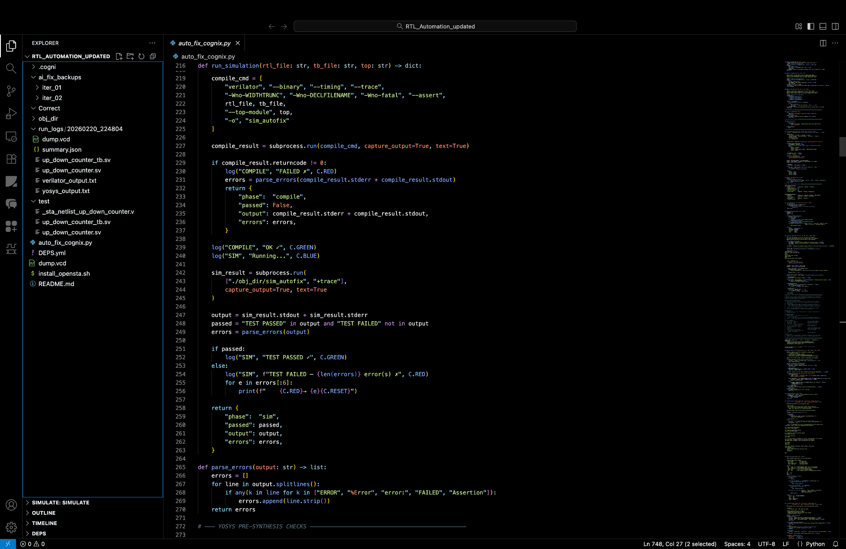
Demo & Results
Project Directories

Slide 10
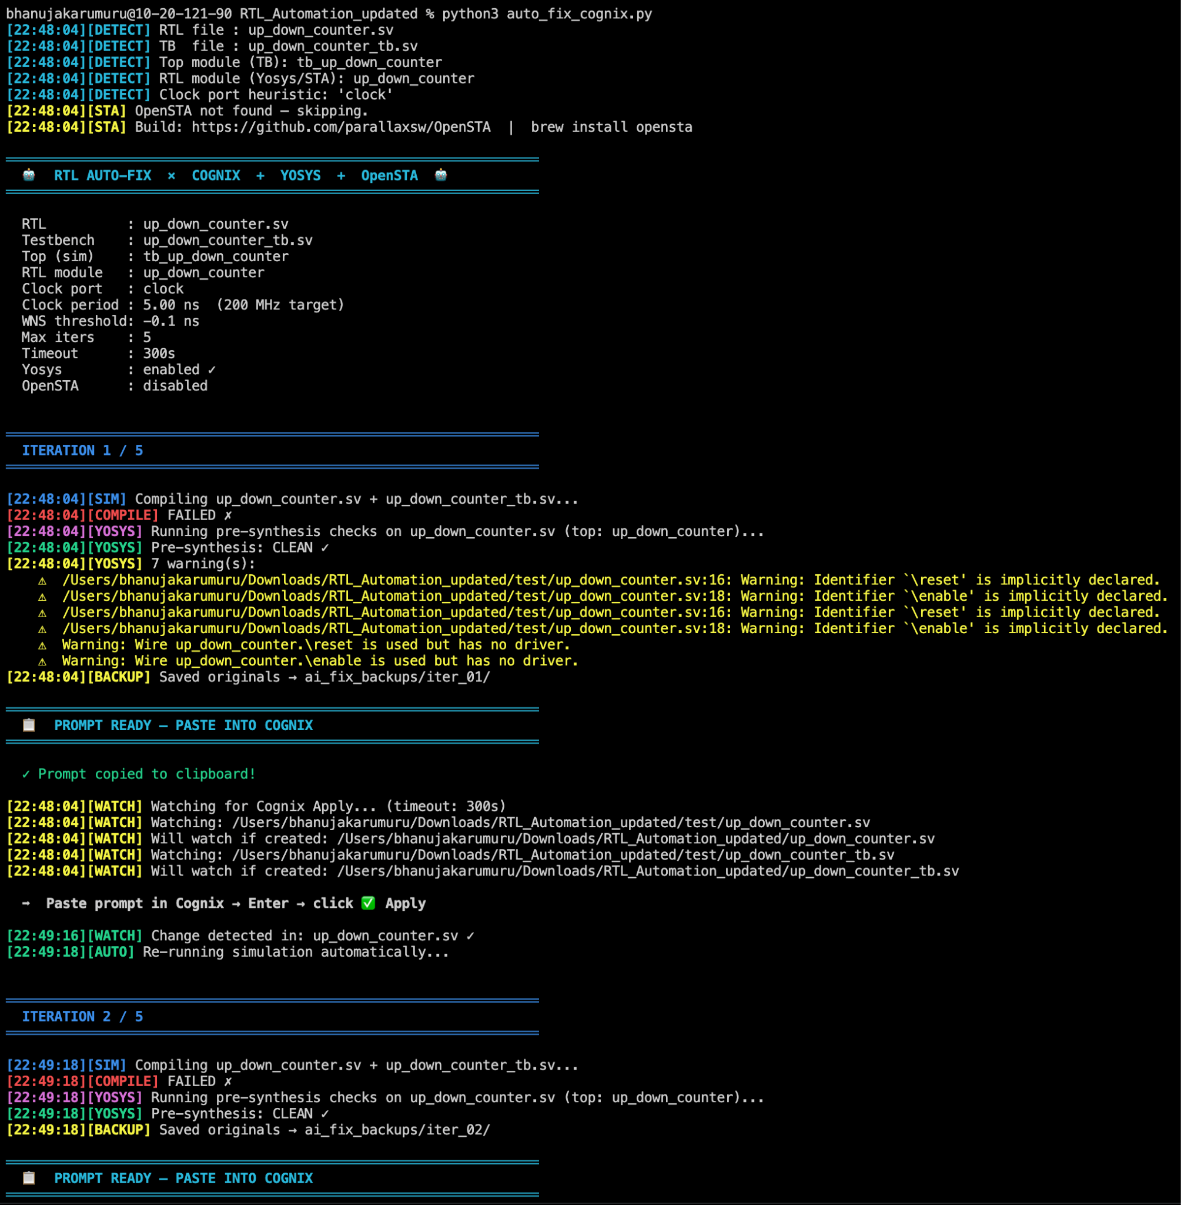
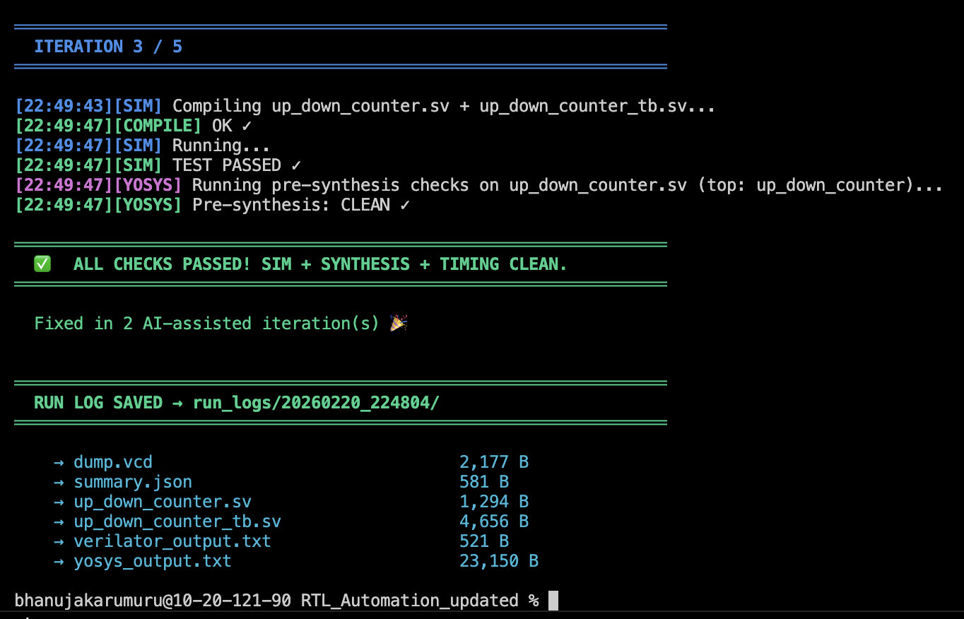
Demo & Results
Terminal Process
< 60s
5
Full Pipeline Run
Max Fix Iterations
Sim + Synth + Timing
Configurable via --max

Slide 11
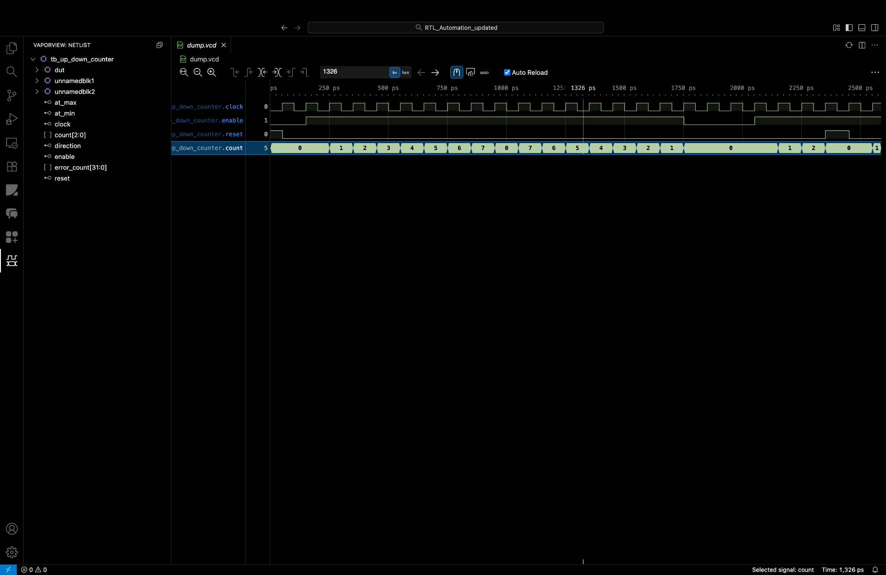
Demo & Results
WaveForm
WaveForm of “up_down_counter_tb”

Slide 12
Tech Stack
SIMULATION
--binary --timing --trace | SystemVerilog | VCD output
Verilator
REQUIRED
PRE-SYNTHESIS
read_verilog -sv | hierarchy -check | synth | check -assert
Yosys
Optional
TIMING STA
NanGate45 Liberty (auto-dl) | WNS/TNS | Critical path report
OpenSTA
Optional
AI FIX ENGINE
Context-rich prompts | ACI Apply button | File-watch loop
Cognix (ACI)
REQUIRED
LANGUAGE
subprocess | pathlib | watchdog | argparse | json logging
Python 3.10+
REQUIRED
HDL
RTL + Testbench (.sv) | $dumpfile/$dumpvars | $finish
SystemVerilog
REQUIRED

Slide 13
Future Scope
Phase 1
Phase 2
Phase 3
Phase 4
If Cognix API is provided, the flow of RTL codes can be automated.
Minimizes the necessity of manual labour which is tedious and significantly slower and less efficient.
MCMM Timing Awareness - AI optimizes RTL across multiple PVT timing corners
Design Space Exploration (DSE) - AI evaluates architectures for latency, area, throughput
Explainable AI Debugging - Generates explanations for every RTL code fix
Mixed-Signal Co-Simulation Support - Integrates Verilog-AMS/SystemC for SoC debugging
CI/CD Hardware Integration - Automates RTL validation during design commits
FPGA-in-the-Loop Validation - Tests AI-modified RTL on FPGA hardware
Analysis tools shall be integrated into this to perform analysis for pre-layout quality checks.
Thereby, partial layout quality improvement is done without even reaching layout phase.
Cognix then becomes a smart assistant to layout engineers as they progress to generate netlist on tools such as Cadence Genus.
Following that, Layout can be designed on tools such as Cadence Innovus.
Further verification steps performed using tools such as Cadence Tempus, Pegasus and Quantus for full Signoff.
Repeat the process on multiple designs.
Run comparison tests proving how the addition of AI to semiconductor design is a massive boost to manufacturing thereby cutting the shortage globally.
Subsequently figure out techniques to allow for layout engineers to verify and adopt possible designs using the help of AI using layout placement ideas.
All these steps will require funding and support from Cognichip AI.

Slide 14
Thank You
AI-Driven Layout-Aware RTL Optimization Loop
Hackathon 2026

